Slide 1
CS 558: QUANTUM COMPUTING
“Quantum Entanglement and Bell State Generation using Pulse-Level Operations”
Anjali Menghwani
Sreeniketh Aathreya

Slide 2
INTRODUCTION
Our project centers on the use of precise, time-dependent control methods (pulse-level operations) in quantum mechanics to create and manipulate Bell states.
Bell states are crucial for quantum entanglement, where pairs of qubits are linked such that the state of one instantly influences the other, regardless of distance.
This advanced technique enhances the precision and efficacy of entanglement, pivotal for quantum computing and information processing applications.

Slide 3
FOCUS
This project explores the use of pulse-level control, which allows for fine-grained manipulation of quantum states, over traditional gate-based methods on Amazon Braket.

Slide 4
WHAT WE AIM TO ACHIEVE
To define and apply custom pulses to qubits and create a Bell pair using Amazon Braket's pulse-level control features.
Understand if pulse-level control can enable the implementation of quantum operations that are challenging or infeasible with standard gates.
Understand how pulse-level control compare to gate-based approaches in terms of
performance, fidelity, and resource efficiency.
Understand the limitations and challenges associated with pulse-level control on Amazon Braket.
Investigate how noise affects the fidelity of the prepared Bell pair by artificially introducing noise in the pulses.
Optimize the pulse parameters (duration, amplitude, shape) to maximize the fidelity of the prepared Bell pair. This included multiple iterations and experiments.

Slide 5
Amazon Braket and Pulse-Level Control
Amazon Braket: A fully managed quantum computing service that supports both high-level gate constructions and low-level pulse-level manipulations.
Pulse-Level Control: Enables the definition and application of custom electromagnetic pulses to qubits, allowing for tailored quantum operations and system optimizations.

Slide 6
Bell State Circuit
Bell states are highly entangled two-qubit states
Canonical circuit: Hadamard on qubit 1, then CNOT from qubit 1 to qubit 2
This creates the Bell state (|00> + |11>)/sqrt(2)
But Aspen M-3 doesn't directly implement Hadamard and CNOT gates

Slide 7
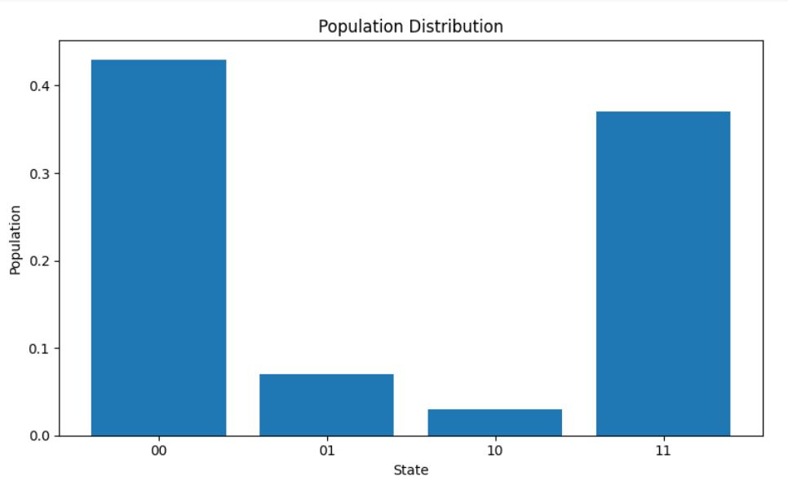
Bell State Circuit

Slide 8
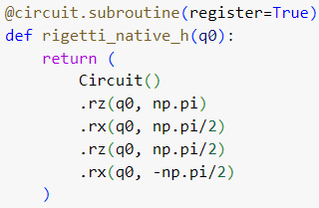
Decomposing Gates
Hadamard can be decomposed into RX and RZ rotations
CNOT can be replaced by Hadamard - CZ - Hadamard sandwich
CZ is a native gate on Aspen M-3, implemented with optimized microwave pulses

Slide 9

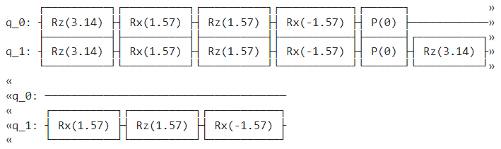

Slide 10
Creating the CZ gate using waveforms
Need to obtain the specific CZ pulse waveform and associated frame
Phase corrections are pre-calculated and applied with shift_phase instructions

Slide 11
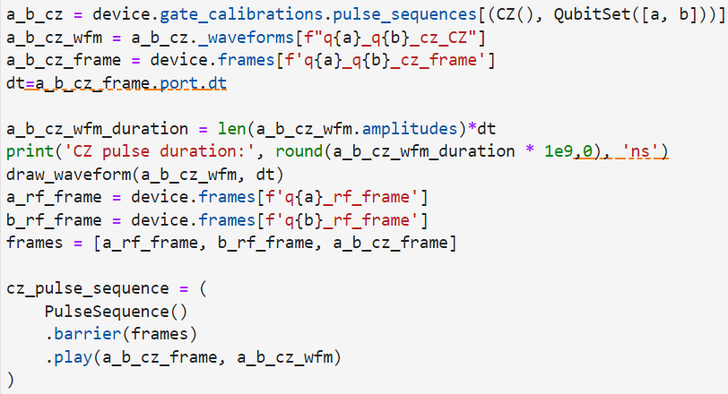

Slide 12
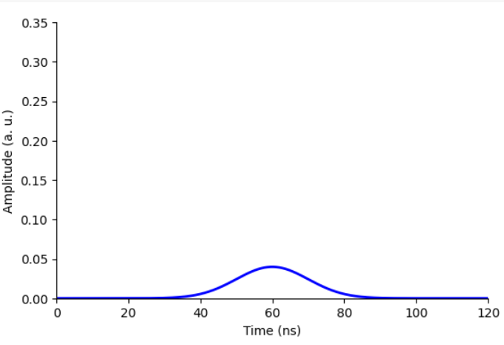

Slide 13
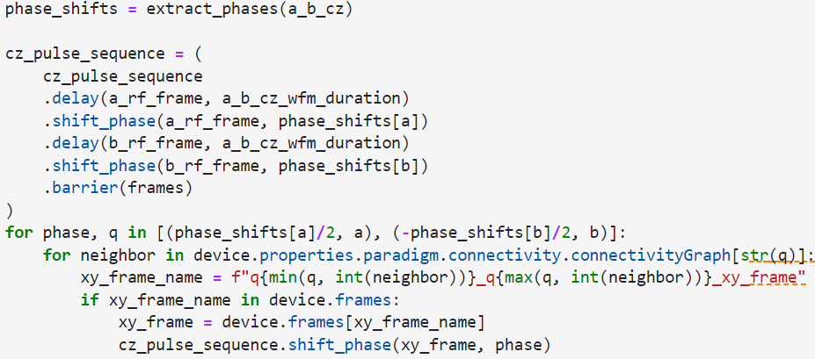
Pulse Sequences using Waveforms

Slide 14
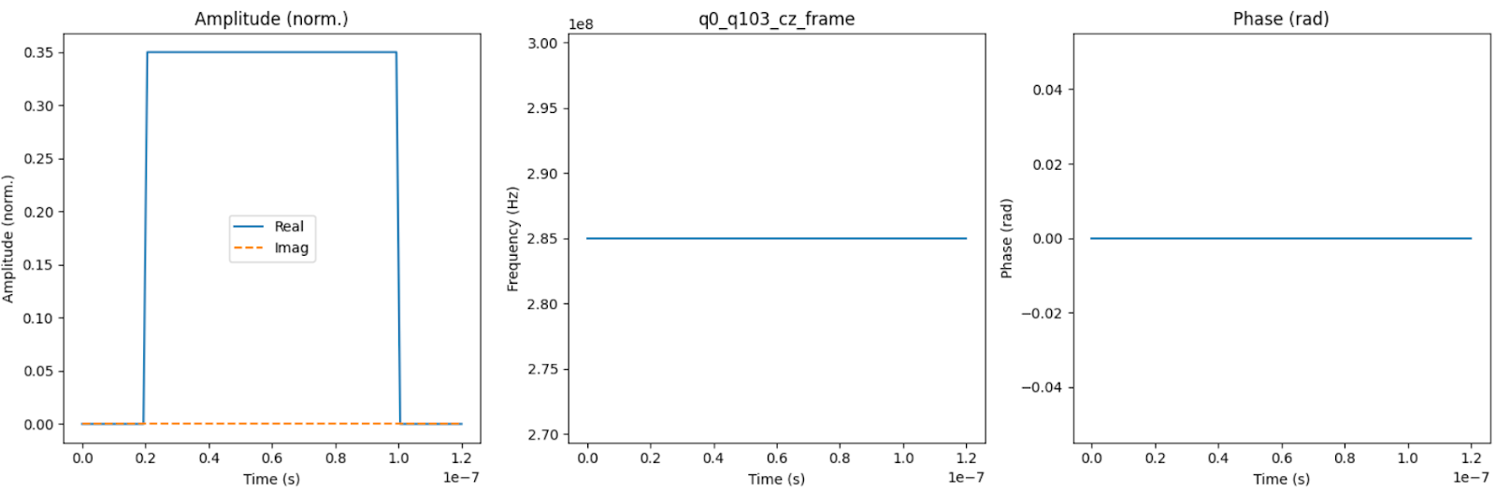
Pulse Sequences after using CZ Waveform

Slide 15
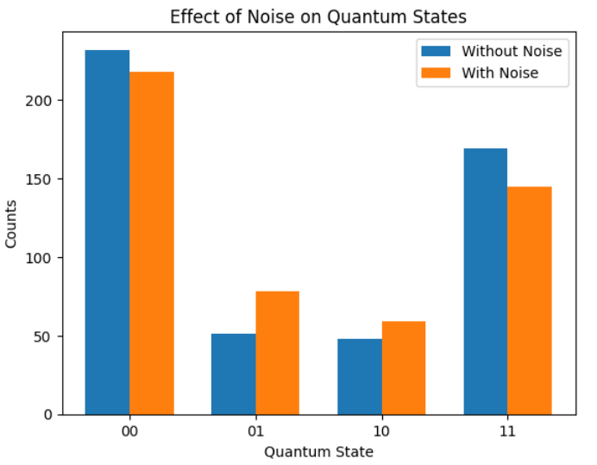
Adding Noise to the Circuit
Depolarizing noise with p = 0.1

Slide 16
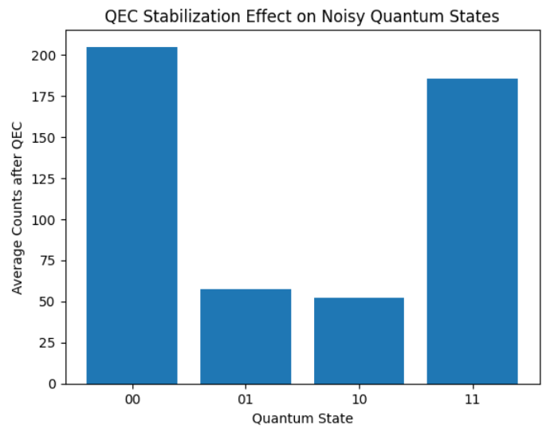
QEC Stabilization of Noise

Slide 17
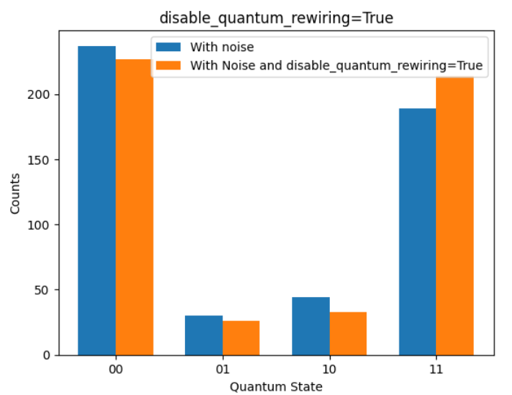
Optimization of Circuit

Slide 18
Bibliography
[1] Amazon Braket Documentation. (2023). Pulse-level control. Retrieved from
https://docs.aws.amazon.com/braket/latest/developerguide/braket-pulses.html
[2] Gokhale, P., Javadi-Abhari, A., Earnest, N., Shi, Y., & Chong, F. T. (2020). Optimized
quantum compilation for near-term algorithms with OpenPulse. arXiv preprint arXiv:2004.11205.
[3] McKay, D. C., Sheldon, S., Smolin, J. A., Chow, J. M., & Gambetta, J. M. (2019). Three-qubit randomized benchmarking. Physical Review Letters, 122(20), 200502.
[4] Shi, Y., Gokhale, P., Murali, P., Baker, J., Ding, Y., Brown, K. R., & Chong, F. T. (2019).
Optimized compilation of aggregated instructions for realistic quantum computers. In
Proceedings of the 24th ACM International Conference on Architectural Support for
Programming Languages and Operating Systems (pp. 1031-1044).
[5] Cross, A. W., Bishop, L. S., Sheldon, S., Nation, P. D., & Gambetta, J. M. (2019). Validating
quantum computers using randomized model circuits. Physical Review A, 100(3), 032328.

